Slide 1
Outreach Training
Girls Inc. Eureka Workshop
Profs. Sunghoon Lee and Phillipa Gill
College of Information and Computer Sciences
UMass Amherst

Slide 2
Outreach Training Agenda
Introductions
Event Description and Goals
Event Logistics and schedule for the day
Volunteer role, goals and best practices
Scratch Crash Course
The Play It/Code It activity

Slide 3
Event Description
The event is held at the Design Building.
15 high school girls (12 – 18 years old) and teachers from Holyoke area will participate.
Long-term goal is to contribute to broadening the participation of women in the technology workforce.
Immediate goal is to give girls a sense of education and career opportunities in engineering and CS (STEM in general).
The goal of our activity is to provide a fun and engaging introduction to basic ideas in computational thinking, programming, and embedded systems.

Slide 4
Event Logistics and Schedule
Setup (8:50-9:50)
Activity Sessions (9:50-11:50)
Teardown (11:50-12:20)
Room configuration

Slide 5
Logistics and Schedule: Setup
Setup Team 1
8:50: Meet at the Design Building room 162. Laptop will be available in the room. Verify arrangement of tables, chairs, power, AV.
8:55-9:40: Unpack, plug in, boot-up, log-in, and install drivers & SW on 8 laptops. Verify all laptops working.
9:40-9:50: Setup team break. Get name badge at registration table.

Slide 6
Logistics and Schedule: Activity Sessions
9:50-10:00: Introduction & Demo to students
10:00 – 11:50: Activity Session
11:50-12:10: Remove code from laptops, power down, pack up all gear.
12:10-12:20: Return laptops (??)

Slide 7
Logistics and Schedule: Room Configuration
We will use the first 4 tables.
You will be assigned to cover 2 teams (4 girls).
Front
Back

Slide 8
Volunteer Role and Goals
Role: Facilitate, guide, and coach.
Goals 1: Ensure all the girls have a positive experience with the activity.
Goal 2: Keep the girls engaged and on-task for the full session.
Goal 3: Try to keep frustration levels low.
Goals 4: Convey basic material about computational thinking and programming including how to break down a problem into a sequence of steps, and how to use basic control flow (looping and conditionals).

Slide 9
Volunteer Best Practices
Break the ice. Introduce yourself. Ask some questions about what school they are from, if they have programmed before.
For questions about how to complete the exercises, try to guide them in terms of how to think about the problems. Try prompting questions like: “How could you break this down into steps?”, “Can you think of what the first step could be?”, “What should the next step be?”
You can directly answer any questions about the ArduBlock interface: where blocks are; how to drag, drop stack, rearrange, remove blocks; how to change between the sprites to add code to them.

Slide 10
Volunteer Best Practices
For questions about what blocks do, or what a piece of code might do, try to encourage experimentation with prompts like “why don’t you try it out and see what happens.”
When an initial solution doesn’t work, encourage them to debug: figure out where the problem is and try something else.
You need to watch out for frustration levels if a group is having trouble, particularly groups with no prior experience. You should try encouragement first, then give hints, then use redirection (“why don’t you go on to the next exercise and come back to this one later).

Slide 11
Volunteer Best Practices
Let advanced groups work independently to the end of the main exercises and get them to demo their solutions for you. If they didn’t get the most efficient solutions, encourage them to think a bit more.
Maybe teaming up those students who have programming experience?
For groups that complete the main exercises, they can continue to modify the program we provide by adding enhancements. Get them to explain what they want to try, and check in periodically. They can do anything within the structure of the game. Suggest enhancements and challenge them with harder tasks until time is up.

Slide 12
Volunteer Best Practices
Ask for help if you get into a situation that you’re not sure how to deal with, or a question you don’t know how to answer, ask for help from Ivan or Phillipa.
As a general rule, volunteers do not touch laptops during hands-on sessions. Your goal is to talk participants through problems and guide them to come up with solutions on their own. If something outside the activity comes up (like a software crash or a hardware issue), then you can take over the laptop to get them back on track with the activity as quickly as possible.

Slide 13
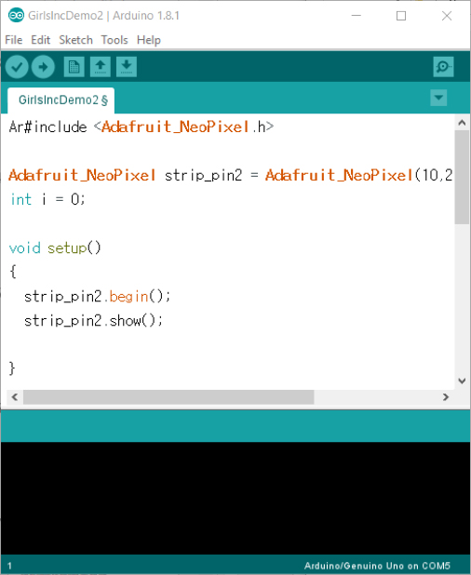
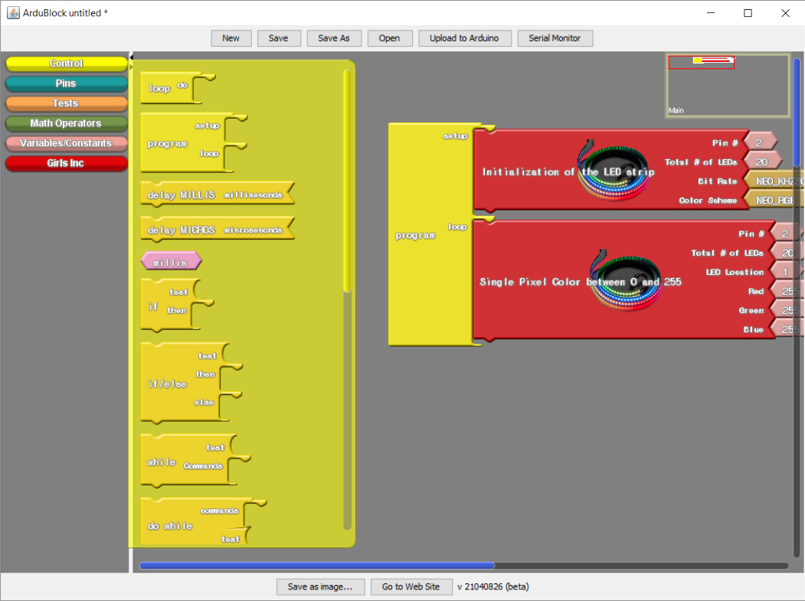
Arduino & ArduBlock
Blocks
Arduino IDE
Block Categories
Code

Slide 14
ArduBlock
An Arduino “add-on tool” that is designed in JAVA based on MIT’s Scratch platform.
It simply provides a graphical UI, which converts the code into the Arduino code
You will be able to see the converted “Arduino Code” every time you compile the “Block Codes”
Programs are created by dragging command blocks from the blocks panel to the code area.
Blocks are arranged in categories. We will mostly be using “control blocks” and custom blocks that we designed for “Grils Inc”.

Slide 15
ArduBlock
Blocks snap together like puzzle pieces in the code area to form instruction sequences.
When you click on a block and drag it, it drags all blocks below it in the stack.
You delete blocks by dragging them out of the code area to the “Block Category” panel
You can run individual blocks or stacks by double clicking on them
To start a program running, click the “Upload to Arduino” button on the ArduBlock IDE.

Slide 16
Activities
A total of 5 parts with sub-activities and incremental difficulty.
Part 1: Connecting wires together
Part 2: Learn how to use ArduBlock
Activity 1: upload the code to Arduino
Activity 2: changing color of 1 LED
Activity 3: changing the position of the LED
Part 3: How to get blocks to do more (how to program)
Activity 1: manually changing the color of an LED from Red to Green to Blue every 1 second
Activity 2: manually changing the position of an LED to the right 4 times.

Slide 17
Activities
Part 4: Learning about loop & variables
Activity 1: using a loop to move the LED
Activity 2: using a loop and if-statement to change colors of all LEDs
Part 5: Adding a sensor to control
Activity 1: Turn on/off the LEDs with a color of choice every 0.5 second
Students MUST use only 20 LEDs, otherwise Arduino disconnects itself from the USB, i.e. IDE does not recognize the board.
How to solve it: disconnect LEDs from the Arduino board, upload a dummy code, and reconnect the LEDs
Activity 2: use “analog read” to control the delay.

Slide 18
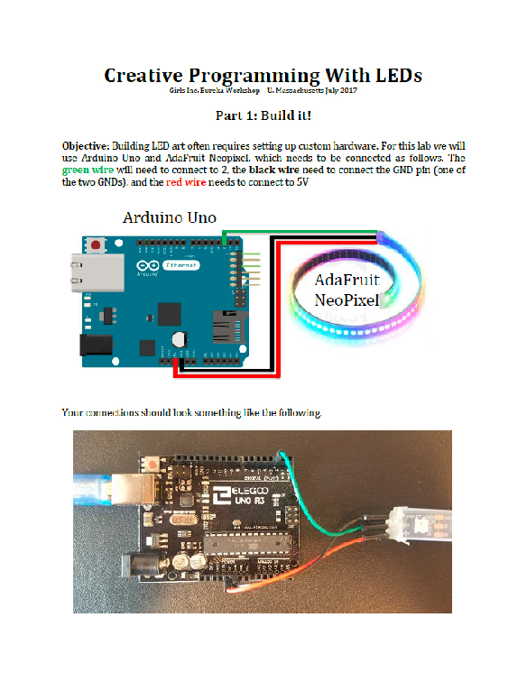
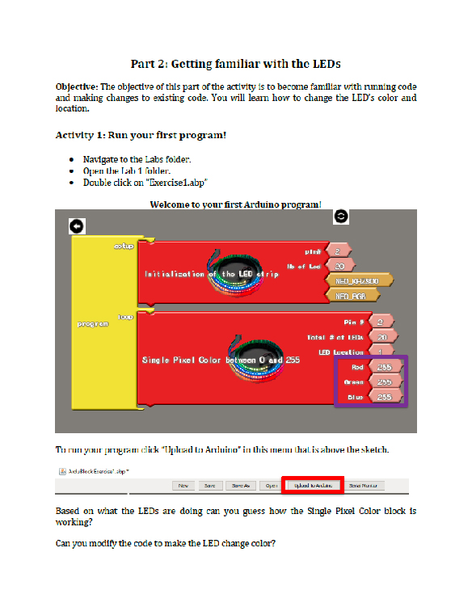
The Activity: Play It/Code It – Instruction Handout

Slide 19
Questions?

